Slide 1
The R Drive
Networked Staff Storage

Slide 2
What is the R Drive?
The R drive is Ritter’s network storage.
Organized way to save documents for individuals, departments, or the whole staff.
Available only from Staff computers here in the building.
Backed up weekly to ensure that the data isn’t lost or damaged.
Secured to only allow staff or personal access, depending on folder type. If you don’t use a personal login, it will have open access so you can use it from a shared computer.

Slide 3
Organization
Departments can have a folder for sharing things they will need around the library. If your department doesn’t have one, talk to Paul about creating one.
Each person has a folder under the “Personal” folder in the R Drive. They should all be first initial last name. ex “plima”
Any folder of use to all staff will also be separated and organized out. Documents in the Documents folder, forms in the Forms folder.

Slide 4
Rules
Please be courteous! Do not delete another person’s files without asking. Security should keep you from doing this accidentally.
Keep your folder organized and only store things that are important to keep backed up. Delete things you no longer need.
The R Drive should be for work related documents only. Please don’t back up your Ipod collection with it.

Slide 5
Using the R drive

Slide 6
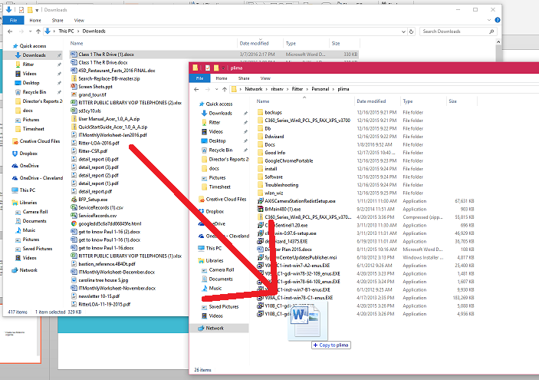
Drag and drop or copy and paste files into your folder.

Slide 7
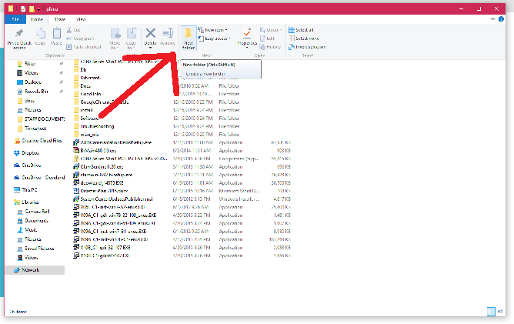
Add folders to help organize. Give them meaningful names like “Tech Challenge”.

Slide 8
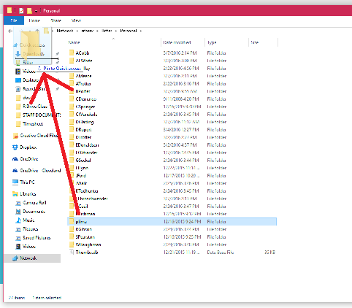
You can create a shortcut by dragging your folder to the Quick Access at the top left of the file explorer.

Slide 9
Homework
Must be done on a staff machine:
Navigate to your personal folder. Create a subfolder called Tech Challenge.
Create a shortcut to your personal folder.
You can always ask for help from a tech coach if you need it.

